Slide 1
Elaboration Phase Specification
Tech Lithe Creations

Slide 2
Agenda
Brief Recap of Current Issues
System Requirements
Prototypes
Financials
Notes:
(tyler)

Slide 3
Brief Recap of Current Issues
Data Recovery and Business Continuity are compromised
The website needs to refine some desired pages, such as an “about us,” calendar of events page, and a board members page.
Postage costs are higher than they need to be, due to a lack of online newsletter.
The KYHBPA is currently unable to accept online donations.
Notes:
(cameron)

Slide 4
System Requirements
Functional Requirements
The cloud storage system will backup all important and prominent data to allow for recovery and business continuity.
The website will incorporate an online payment system, so the KHBPA can receive donations online.
The website will push content and news to users to cut postage costs.
The website will be able to generate reports for users.
The website will have a form so members can register online.
The website will contact users when they need to be contacted, such as when a report request has been filled.
The website will give medicine change notices.
The website will include a dashboard about races (delays, track conditions, etc.).
The website will have an “about us” page that will describe their mission statement and the services the KHBPA offers.
The website will have board member biography pages that contain photographs, short biographies, and contact information of key board members.
The website will have a calendar of events page.
The website will have a page with membership benefits and an outline of membership requirements.
The website will have a tool to poll members for decision making.
The website will have a page for meeting minutes between the horsemen committee members.
The website will have a page with links to partner organizations such as TAA, the KY Race Tracks, and contact information for each partner.
Notes:
(savanah)

Slide 5
System Requirements
16. The website will be directly integrated with the KHBPA social media accounts.
17. The website will host a blog.
18. The website will have a message from the president page.
19. The website will be mobile compatible.
20. The website will have a racing/gambling education page.
21. The website will allow members to upload photos to the website after the photo has been approved by a KHBPA employee.
22. The website will have a photo gallery of relevant photos.
Nonfunctional Requirements
Any code written for the website will use a CMS (WordPress).
Website content will be easily editable by employees of KHBPA.
The website will be progressive, youthful, and marketable (“shock and awe”)
The website will be visually distinct from similar organizations.
Notes:
(savanah)

Slide 6
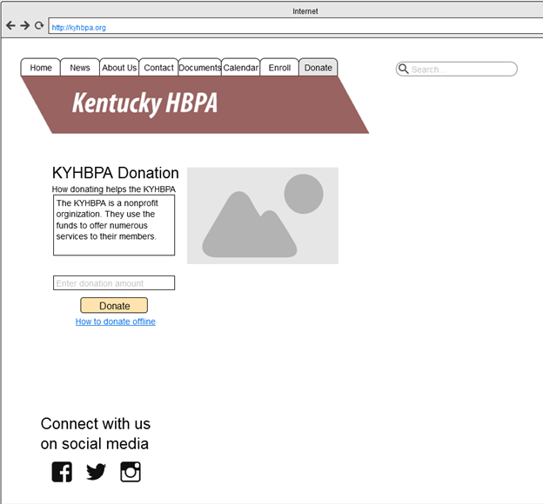
Making Online Donation Prototype

Slide 7
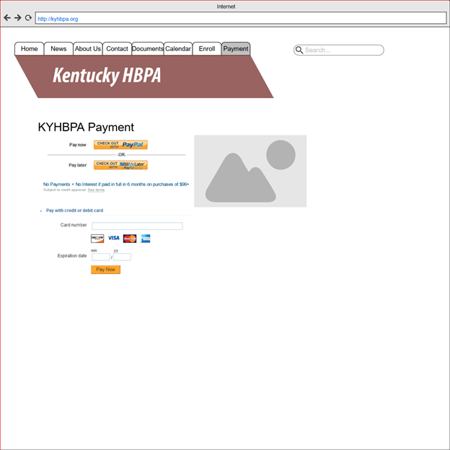
Paying Transaction Online Prototype
Notes:
(ryan start)

Slide 8
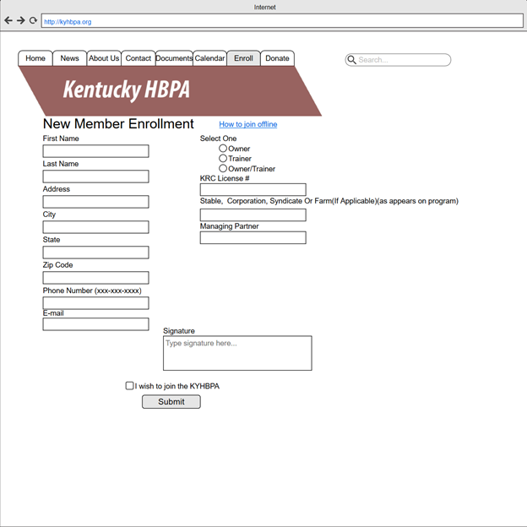
Submitting Digital Signatures Online Prototype

Slide 9
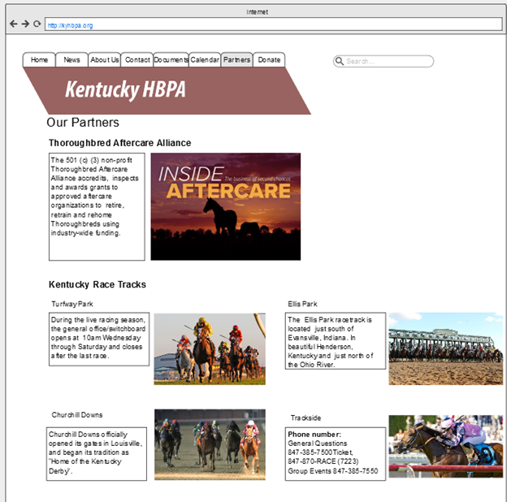
Accessing Partner Organizations Prototype

Slide 10
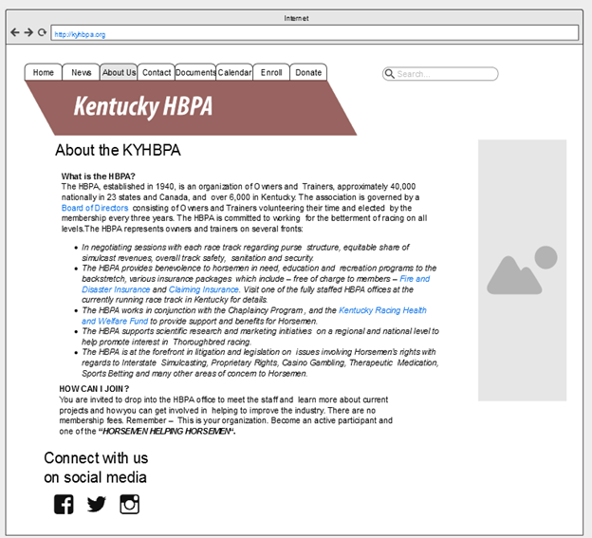
Accessing “About Us” Page Prototype

Slide 11
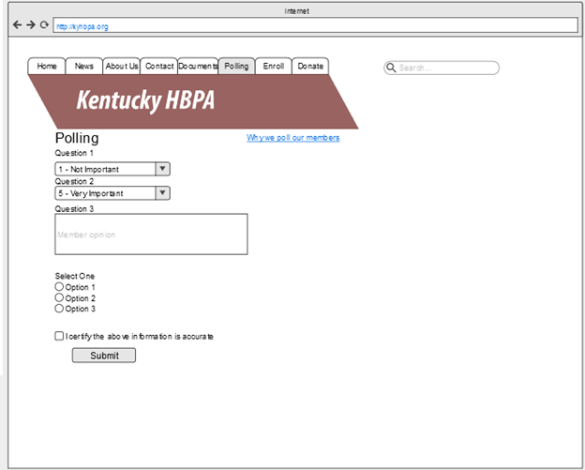
Polling Members Prototype

Slide 12
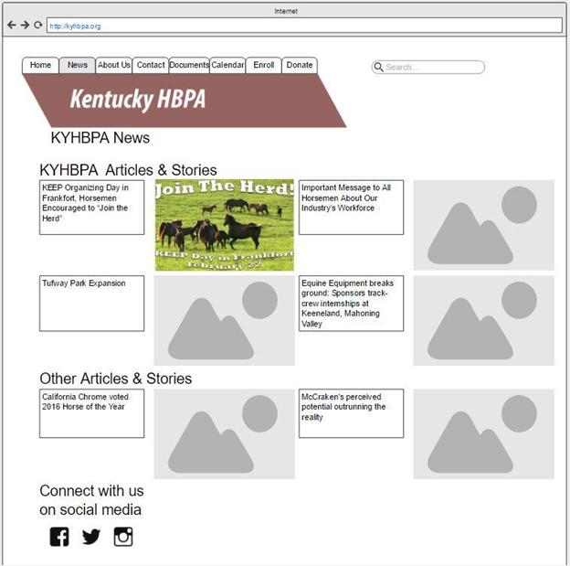
News Page Prototype

Slide 13
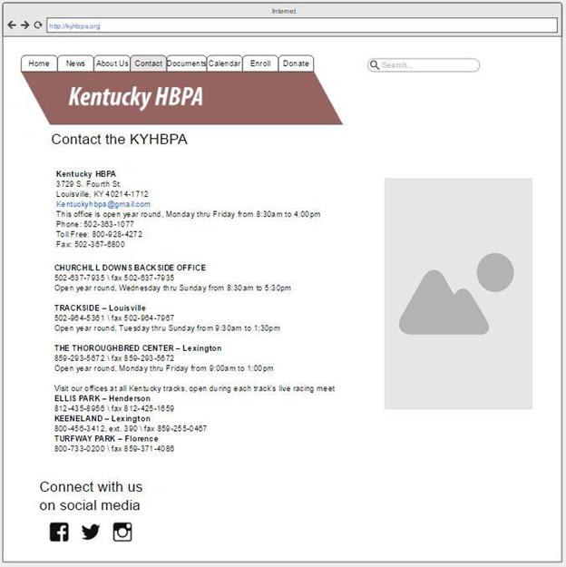
Contact Us Page Prototype

Slide 14
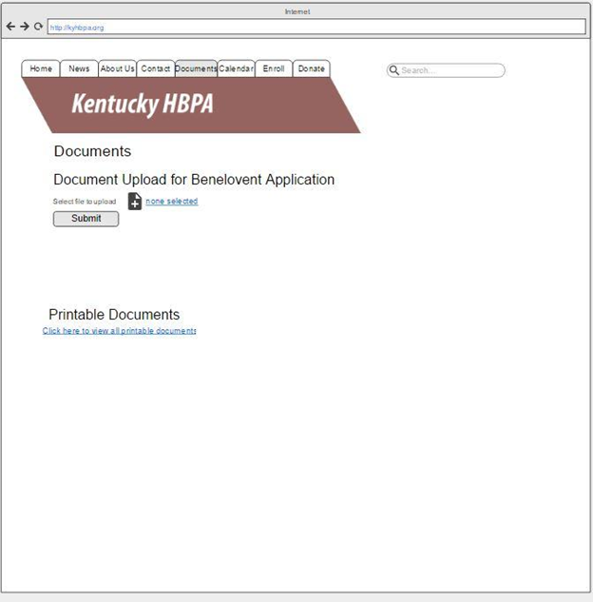
Documents Page Prototype

Slide 15
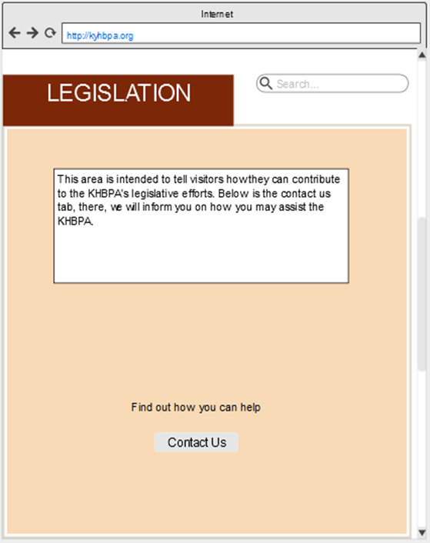
Legislation Page Prototype

Slide 16
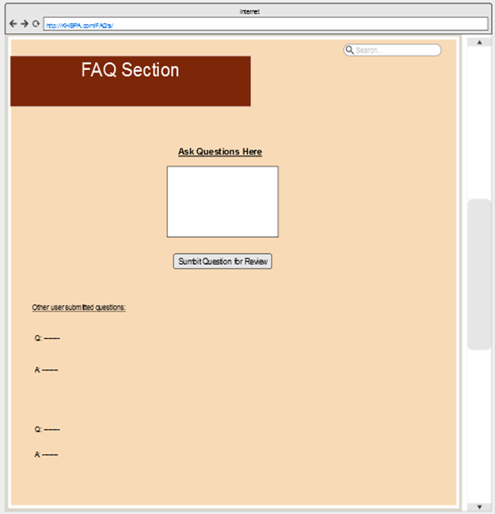
Accessing FAQ’s Prototype
Notes:
(ryan end)

Slide 17
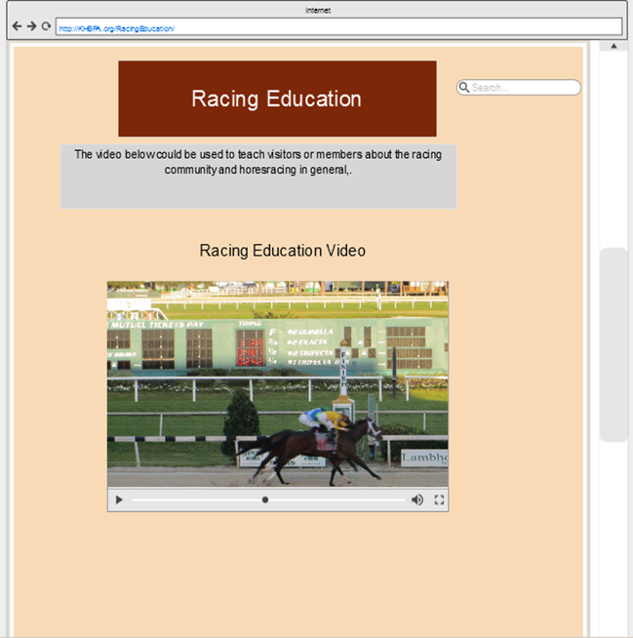
Accessing Racing Education Page Prototype
Notes:
(joe start)

Slide 18
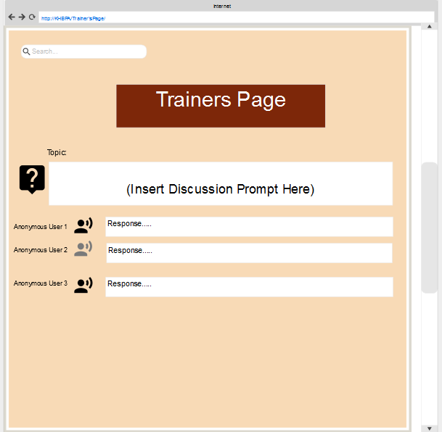
Accessing Trainers Page Prototype

Slide 19
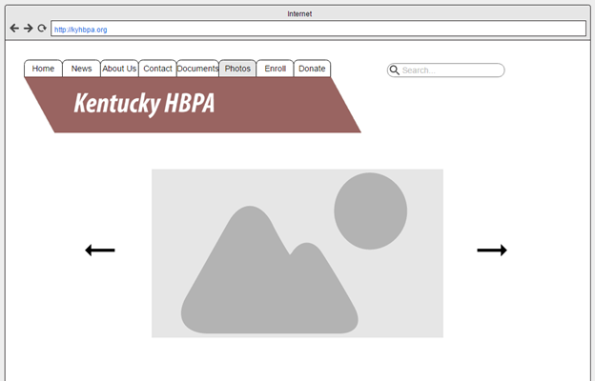
Photo Gallery Prototype

Slide 20
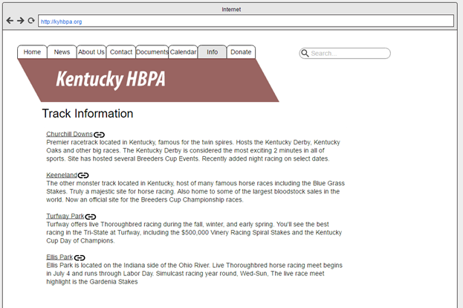
Accessing Track Information Prototype

Slide 21
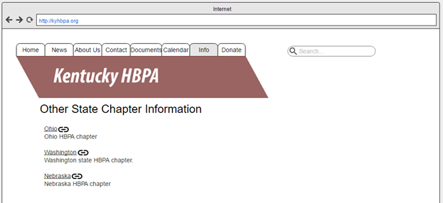
Accessing Other Chapters Prototype

Slide 22
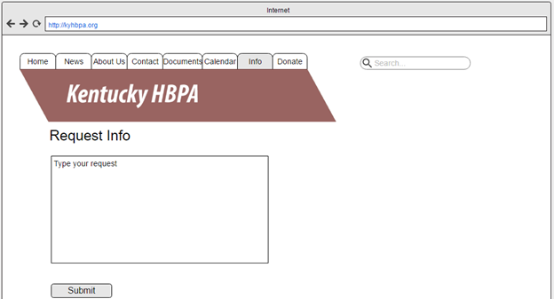
Request Information Prototype

Slide 23
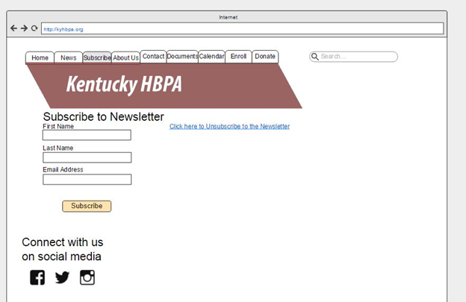
Subscribe to Newsletter Prototype

Slide 24
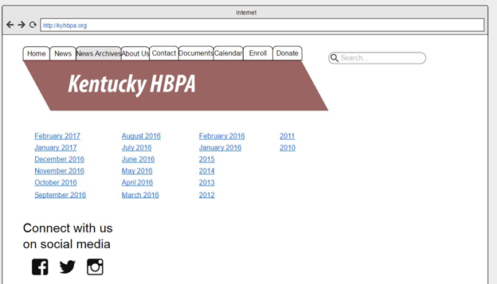
Access News Archives Prototype

Slide 25
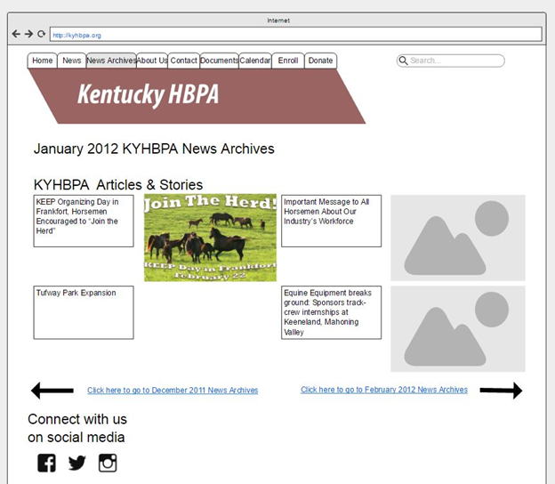
Particular Month News Archives Prototype

Slide 26
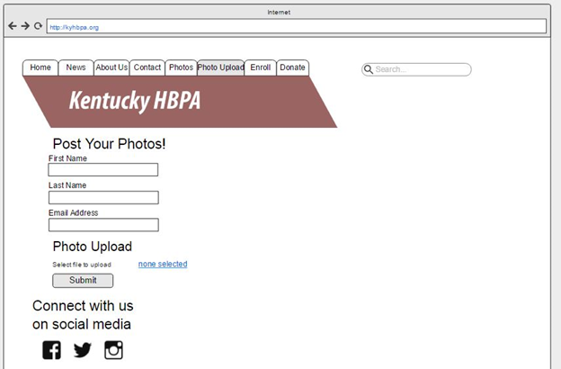
Post Photos Prototype

Slide 27
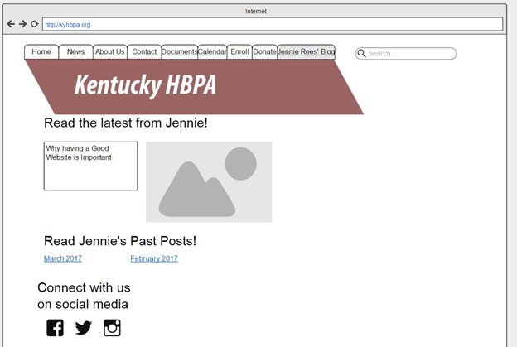
Access Jennie Rees’ Blog Prototype
Notes:
(joe end)

Slide 28
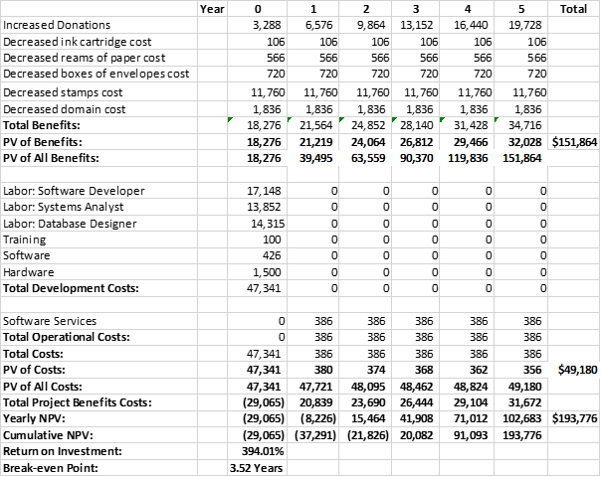
Financials
Economic Feasibility:
How it will lower costs or increase revenue?
Focus on:
Increasing donations
Reducing printing and mailing cost
Break-even: 3.5 years
1st Year Net Cost: $29,065
5th Year Net Benefit: $193,776
394% return on investment
Notes:
(zac)

Slide 29
Agenda
Brief Recap
System Requirements
Prototypes
Financials
Costs - 1st Year Cost: $47,351 ◘ 5th Year Net Benefit: $193,776
394% return on investment
Break-even: 3.5 years
Notes:
(tyler)

Slide 30
Questions?
Notes:
(tyler)

